Slide 1

Using Zoom AI Companion with the Whiteboard Part 5

Slide 2

“Zoom meetings are like a rollercoaster of emotions: from excitement when someone joins to relief when it finally ends.”

Slide 3




Notes:
https://www.youtube.com/channel/UC35ZpwldGw7ZJ5R-2sLijzw

Slide 4
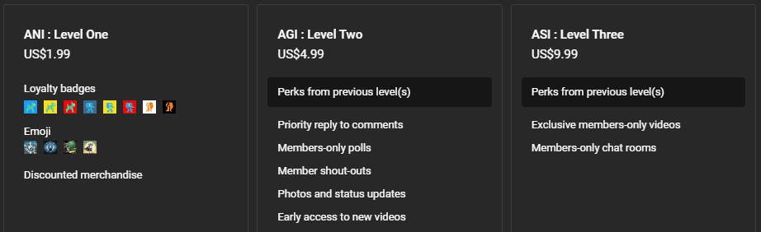

Membership has its privileges
Notes:
https://www.youtube.com/channel/UC35ZpwldGw7ZJ5R-2sLijzw/join

Slide 5

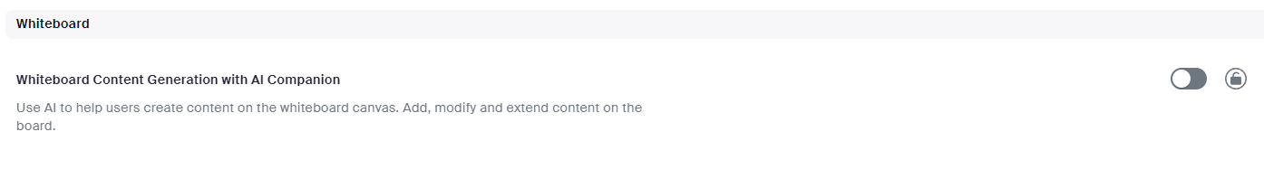
Notes:
https://support.zoom.com/hc/en/article?id=zm_kb&sysparm_article=KB0057623

Slide 6
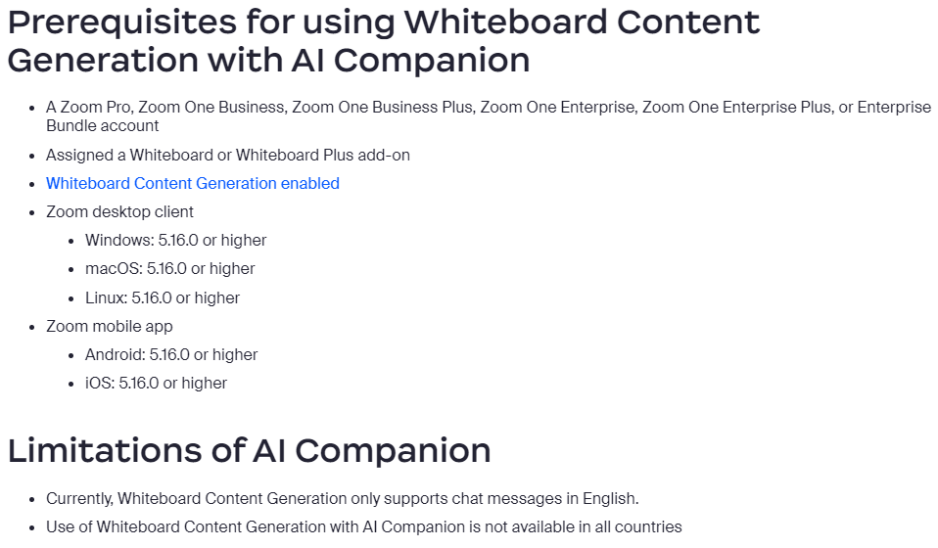
Notes:
https://support.zoom.com/hc/en/article?id=zm_kb&sysparm_article=KB0057610

Slide 7

Generate Sticky Notes
Notes:
https://support.zoom.com/hc/en/article?id=zm_kb&sysparm_article=KB0057610

Slide 8
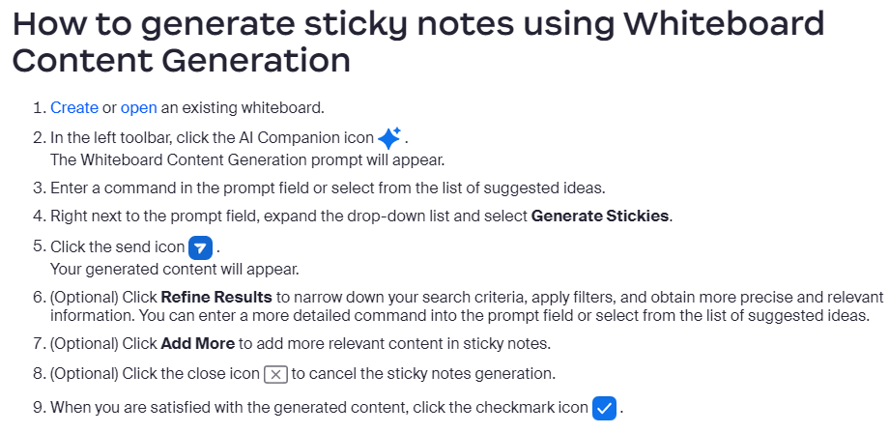

Slide 9
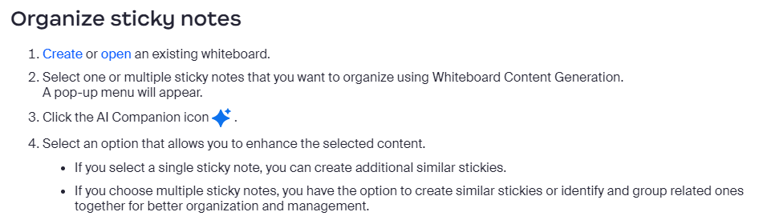

Slide 10
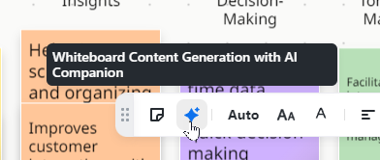
Demo: Generating Sticky Notes

Slide 11

Generate tables
Notes:
https://support.zoom.com/hc/en/article?id=zm_kb&sysparm_article=KB0057610

Slide 12
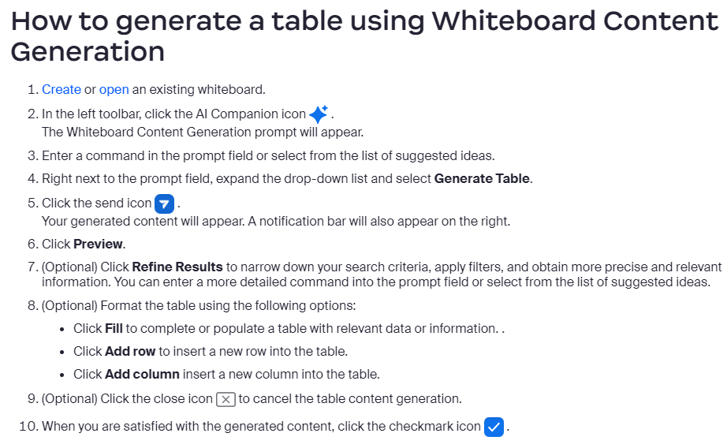

Slide 13
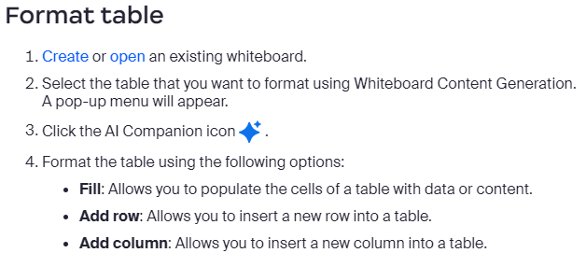

Slide 14
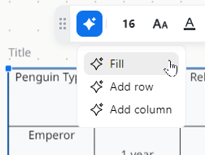
Demo: Generate Tables

Slide 15

Generate Text
Notes:
https://support.zoom.com/hc/en/article?id=zm_kb&sysparm_article=KB0057610

Slide 16
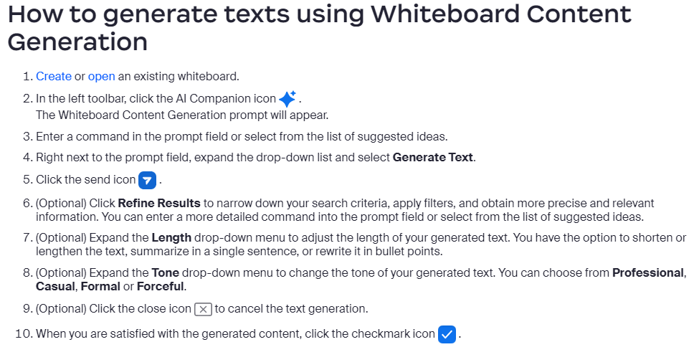

Slide 17
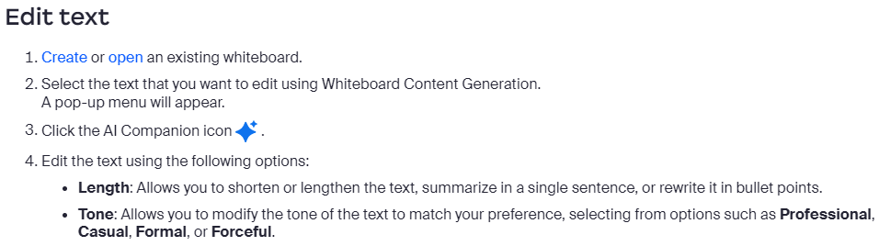

Slide 18
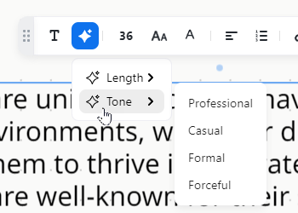
Demo: Generate Text

Slide 19

Generate mindmap
Notes:
https://support.zoom.com/hc/en/article?id=zm_kb&sysparm_article=KB0057610

Slide 20
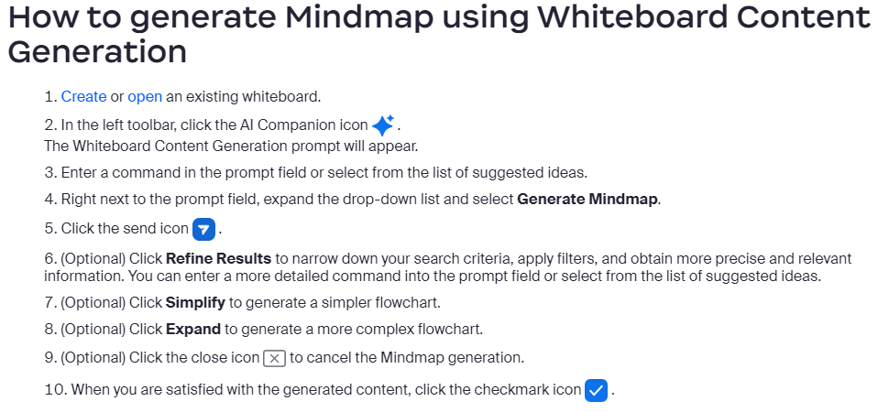

Slide 21
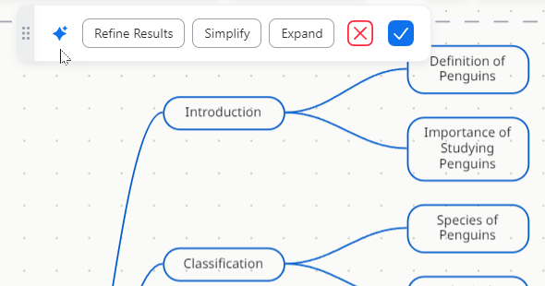
Demo: Generate Mindmap

Slide 22

Generate Flow Chart
Notes:
https://support.zoom.com/hc/en/article?id=zm_kb&sysparm_article=KB0057610

Slide 23
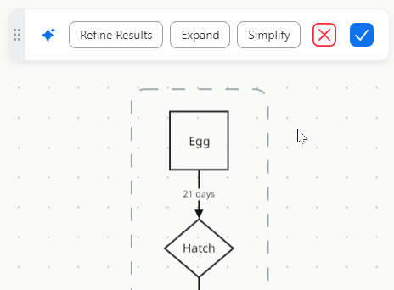
Demo: Generate Flow Chart

Slide 24


